Slide 1
NE 763: Advanced Reactor Materials
Fall 2025
Dr. Benjamin Beeler

Slide 2
Last Time
Graphite has lots of texture and porosity
Thermal stress cracks form…
anisotropic CTE, Mrozowski cracks
Radiation induced shrinkage and turnaround…
interstitials cause c expansion and a contraction, vacancies cause a contraction
aligned porosity closes due to lattice expansion, results in net contraction
once porosity is closed, leads to net expansion (faster expansion in c than contraction in a)
Graphite thermal conductivity…
Irradiation creep is fundamentally important, allows stress relaxation of graphite

Slide 3
TRISO Fuel Performance

Slide 4
TRISO Fuel Performance
Fuel performance models need to be able to account for numerous inter-related phenomena that affect temperatures, stresses, and failure of the material systems
Must be multiphysics, incorporating thermodynamics, chemistry, kinetics, microstructure, mechanics, etc.
Solid fission product swelling
Gaseous fission product swelling
Densification
Thermal conductivity
Fission gas release
CO production
Oxygen transport
PyC layer dimensional change
Kernel migration
SiC failure
Fission product attack

Slide 5
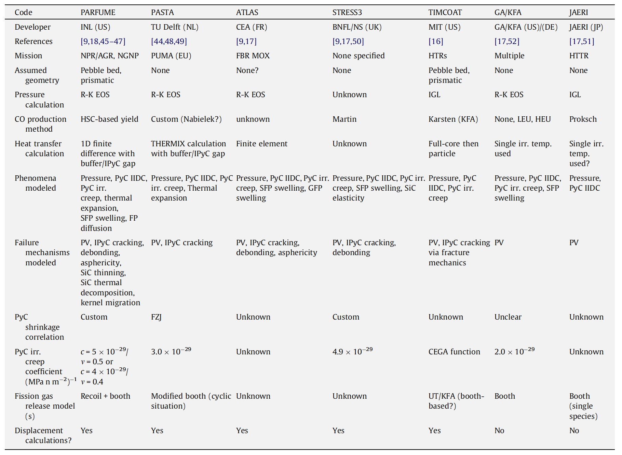
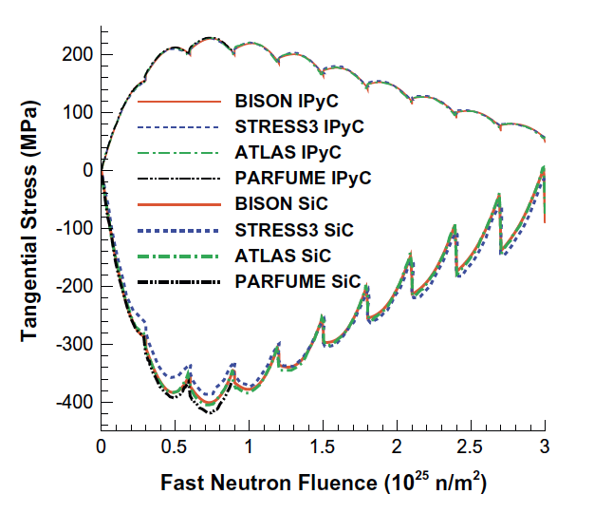
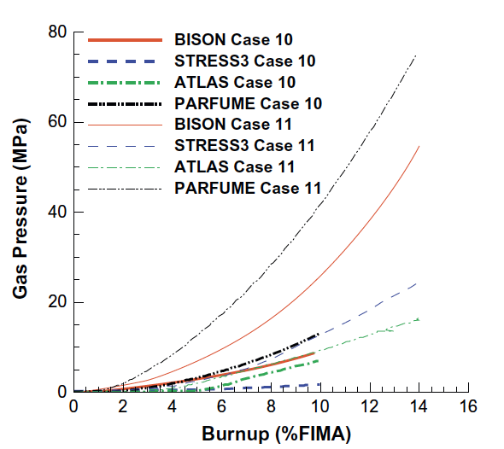
Fuel Performance Codes

Slide 6
SiC Failure
The dominant 1D failure mechanism for TRISO fuel particles involves pressure vessel failure, where the SiC layer develops a through-thickness crack resulting from a tensile stress that exceeds the fracture strength of the material
Modern approaches to pressure vessel failure explicitly calculate separate stresses and through-layer crack probabilities for the SiC layer and each PyC layer

Slide 7
TRISO Stresses
The irradiation causes the kernel to swell and the buffer layer to shrink, thereby modifying the internal void volume available to the fission and reaction gases
The porosity of the buffer leads to the gas pressure being the only force on the load-bearing layers
If the IPyC and OPyC were absent, the gases produced in the fission process would simply stress the SiC layer and, if the pressure were high enough, cause it to fail
However, these tangential stresses are reduced by the presence of the two PyC layers because; under unrestrained conditions they would shrink during irradiation

Slide 8
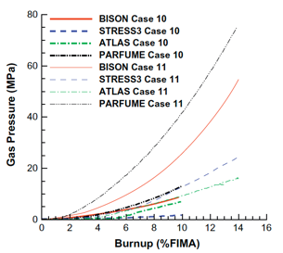
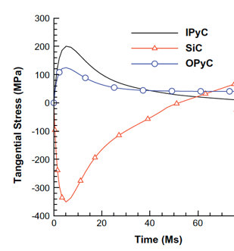
TRISO Stresses
PyC shrinkage will be largely restrained by the SiC layer, and tangential stresses will be generated in both PyC layers, with radial (inward) acting forces imposed on the two surfaces of the SiC layer
In practice, these tangential stresses in the two PyC layers will attain a quasi-equilibrium stress state because their shrinkage is counter-balanced by irradiation creep
The SiC elastic modulus is at least an order of magnitude greater than that of PyC and thus, the dimensional changes and creep strains of SiC are comparatively much smaller than for PyC

Slide 9

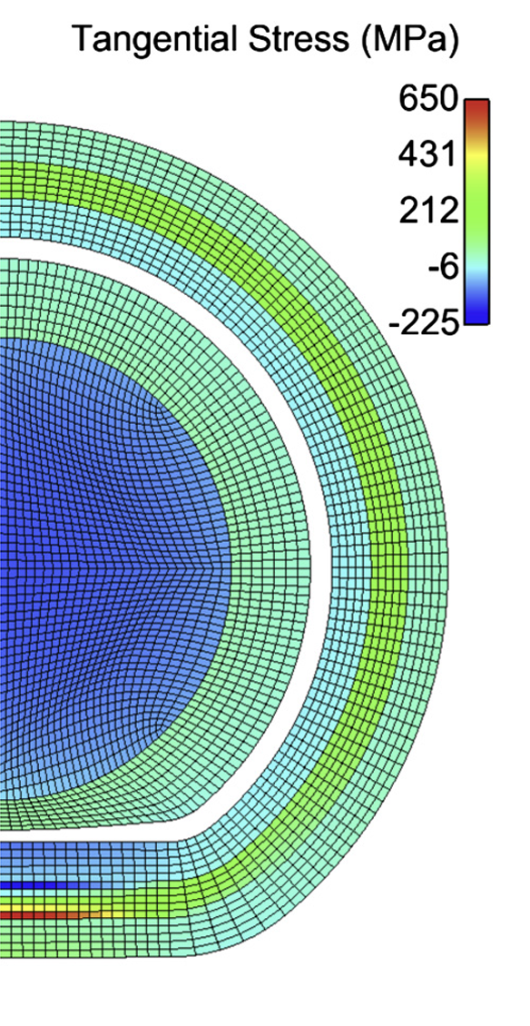
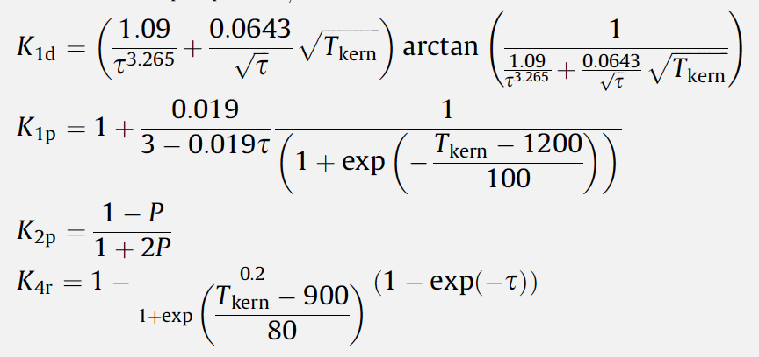

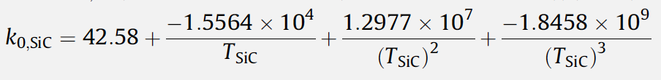
Material Evolution
Ideally, would be able to model and describe 3D modes of failure
Shrinkage cracks within the IPyC layer
IPyC/SiC debonding
Particle asphericity
Kernel migration
SiC coating thinning
Fission product attack

Slide 10
Data needs
There are a number of areas where we lack requisite data, either behavioral or fundamental properties, in order to accurately describe TRISO particle evolution
High-quality high burnup data on TRISO particles is generally lacking, which would enable benchmarking of fuel performance models
Uncertainties and unknowns in fundamental material properties are also abundant, especially with regard to how properties vary as functions of temperature, fast fluence, and burnup
There is significant uncertainty in the irradiation creep constant, the value of Poisson’s ratio in irradiation creep models, and the thermal conductivity of PyC
Predictions for the chemical attack of SiC require effective diffusion coefficients of key fission products in various fuel materials, which are unknown
Fuel properties are the least well understood, especially as the fuel evolves during operation

Slide 11
TRISO Fuel Failures

Slide 12
Fuel Failure Mechanisms
Overpressure
During irradiation, fission gases are released from the kernel into the porous buffer layer. The pressure that is generated exerts tensile forces on the SiC layer of the particle
For UO2 kernels, there is also excess oxygen released during fission which will react with carbon from the buffer to form CO and CO2 gas
Particles are generally sized with a large enough buffer void volume to ensure that they do not fail by overpressure during irradiation
Particle failure is postulated to occur as a result of an insufficient or missing buffer layer that occurs during the coating process

Slide 13
Fuel Failure Mechanisms
Irradiation-induced IPyC cracking
Under irradiation, pyrocarbon (PyC) shrinks in both the radial and tangential directions
This behavior puts the PyC layers into tension in the tangential direction
However, irradiation-induced creep works to relieve the tensile stress in the PyC layer
If the PyC is strongly attached to the SiC layer, the PyC shrinkage provides a strong compressive stress that offsets the tensile stresses generated by gas production in the kernel
High tensile loads, or insufficient creep, can lead to cracking of the IPyC

Slide 14
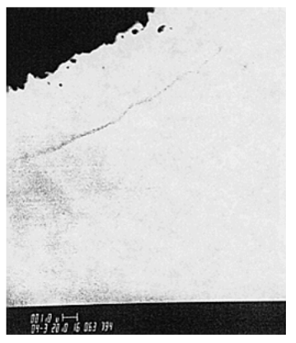
Fuel Failure Mechanisms
Debonding between IPyC and SiC
The debonding is related to the strength of the IPyC/SiC interface
Weakly bonded coating layers can partially detach because of the tensile stresses generated by the IPyC shrinkage under irradiation
A particle for which partial debonding of the IPyC from the SiC has occurred can develop relatively large tensile stresses in the SiC
Irradiation induced creep relieves the stress at longer times

Slide 15
Fuel Failure Mechanisms
Kernel migration (amoeba effect)
Kernel migration is defined simply as movement of the kernel toward the TRISO-coating, which can lead to the kernel penetrating the TRISO-coating
Kernel migration is associated with carbon transport in the particle in the presence of a temperature gradient
A thermal gradient generates different equilibrium conditions for C, UO2, CO and CO2 at either side of the particle
Carbon diffuses up the temperature gradient, the kernel diffuses down

Slide 16
Fuel Failure Mechanisms
Fission product attack
Fission products can be transported from the kernel to the inner surface of the SiC where they interact and can damage and potentially fail the SiC layer
Bigger issue in UC kernels
In UCO kernels, the oxycarbide form of the kernel generally ties up all but the noble fission products (e.g., Pd) as either carbides or oxides, which tend to limit their mobility in the UCO system
However, Pd and Ag transport have still been observed in UCO coated particle fuel

Slide 17
Fuel Failure Mechanisms
Matrix-OPyC interactions and OPyC irradiation-induced cracking
During manufacture, infiltration of the liquid graphitic matrix into the porosity of OPyC caused mechanical weakening
During subsequent dimensional change under irradiation this caused OPyC layer to fail by cracking and debonding from the SiC layer
This has largely been addressed through specifications on the matrix material and on the microstructure of the OPyC
Non-retentive SiC
There are situations where the SiC layer becomes functionally failed or degraded in some way and is no longer retentive of fission products
Diffusive release through intact layers
If fuel temperatures during normal operation approach 1300C, then some of the fission products that are usually retained by the TRISO coating (e.g., cesium) will be able to diffuse out of the particle during normal operation
SiC degradation resulting in permeability
Cesium attack of the SiC and/or CO corrosion of the SiC can allow fission products to be released at high burnup

Slide 18
Fuel Failure Mechanisms
Creep failure of PyC
Under stress, thermal creep of the PyC will occur
In some post-irradiation heating tests, photomicrographs reveal a thinning and failure of the PyC
Such failure has not led to failure of the SiC layer
SiC thermal decomposition
At very high temperatures (> 2000C) the SiC layer undergoes thermal decomposition
The phenomenon is primarily a function of temperature and time and has not played a major role in fuel failure at lower accident temperatures

Slide 19
Fuel Failure Mechanisms
Kernel-coating mechanical interaction (KCMI)
At sufficiently high burn-up values, it is inevitable that all gas gaps between the kernel and coatings will close, thereby resulting in a mechanical interaction between the two
Modelling studies predict that the SiC layer will fail shortly after the onset of KCMI
This failure mechanism could be of increasing importance as attempts are made to achieve higher burn-up values

Slide 20
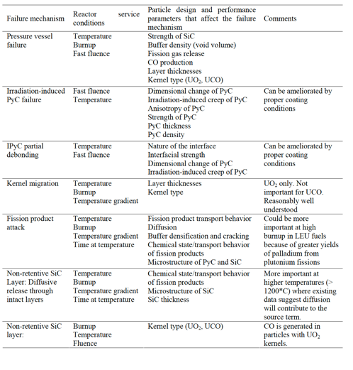
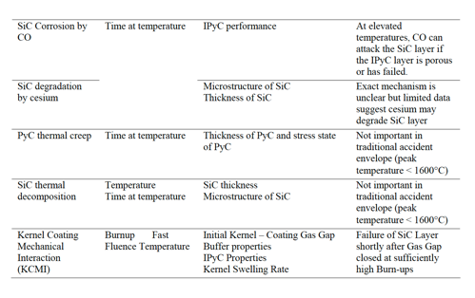
Fuel Failure Mechanisms

Slide 21
Fuel Failure Summary
Overpressure
IPyC cracking
IPyC and SiC debonding
Kernel migration
Fission product attack
Creep failure of PyC
SiC decomposition
KCMI
These failure mechanisms have been observed to some extent in TRISO-coated fuel testing activities conducted around the world
They are in general functions of temperature, burnup, fluence, and temperature (gradient) in the particle and details of the particle design
TRISO-coated fuel is usually designed such that none of the fuel failure mechanisms are expected to be significant

Slide 22
Material Performance in He

Slide 23
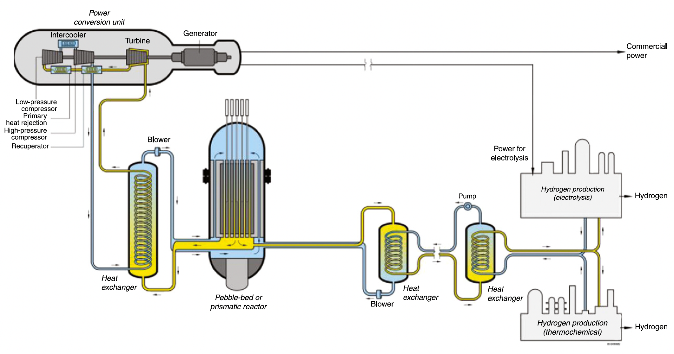
High Temperatures
Current designs target 750 C coolant outlet temperatures
Process heat requirements may require outlet temperatures up to 950C
The most critical metallic component in the VHTR system is the intermediate heat exchanger (IHX)
The high temperatures and long duration of operation restrict IHX material selection

Slide 24
Flow and Impurities
In the reactors under consideration, the gas pressure is typically between 5 and 7 MPa
The coolant is circulated at high velocity, sometimes over 100 m/s
Operating experience has shown that the primary He coolant tends to contain H2O, H2, N2, CO, CO2, and CH4 at concentrations of a few parts per million
These are the primary drivers of corrosion in He-cooled systems
Reactor systems need to have extensive gas cleanup systems associated with the helium coolant flow to keep the total impurity levels in the helium below typically 10 ppm
Active control should be maintained on the H2O and CO concentrations to reduce oxidation of the graphite
Molecular sieves are effective in capturing most of the gaseous impurities

Slide 25
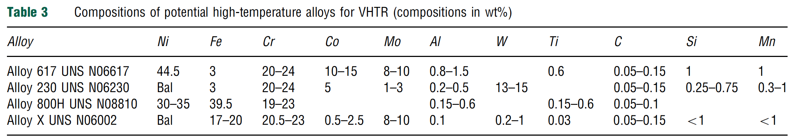
IHX Materials
The desire for higher temperature operation led to selection of nickel-based alloys
These alloys rely on the formation of a chromia layer for long-term protection from environmental degradation
The alloys are primarily solid-solution strengthened with carbides on the grain boundaries to improve creep resistance

Slide 26

IHX Corrosion in VHTR
Interplay between the alloy surface, temperature, and gas composition determines whether corrosive oxidation, carburization, or decarburization occur
Carburization is associated with low-temperature embrittlement, and decarburization is linked to reduced creep rupture strength
Ideally, a continuous self-healing, impermeable passivating oxide layer is needed to establish the most corrosion resistant alloy
There is a critical temperature above which the oxide layer is unstable, and CO production will occur

Slide 27
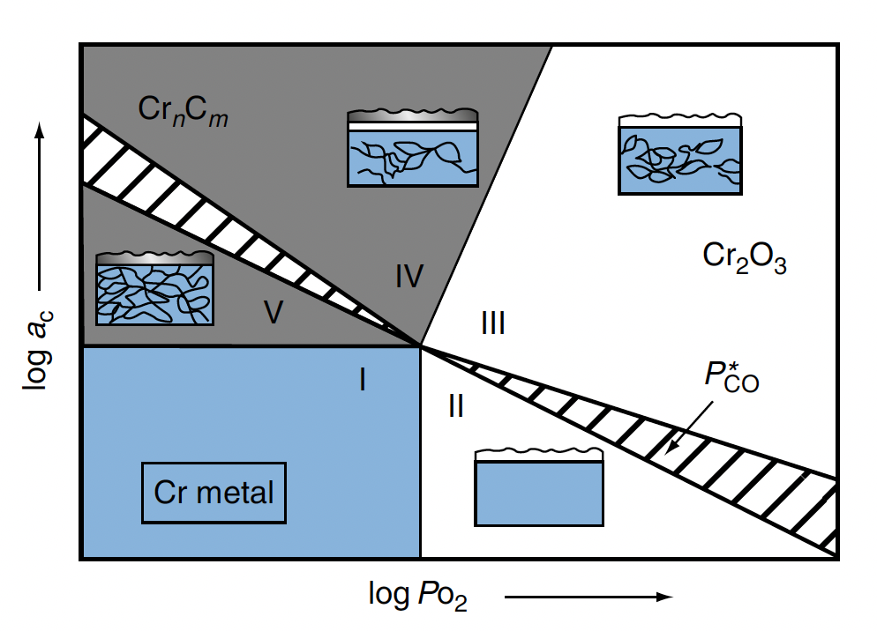
Alloy 617 Stability
Alloy 617 is the leading candidate for use in the VHTR heat exchangers because it has the highest creep strength of the solid-solution alloys under consideration for temperatures above 850C
Five conditions: I – strong reduction; II – decarburization; III – stable external oxide; IV – mixed surface oxide and carbide; and V – strong internal and external carburization
Zone 3 is optimal for stability

Slide 28
Fabrication

Slide 29
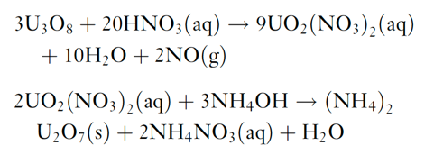
Fuel Kernel Fabrication
The sol–gel technique for kernel microsphere preparation is based on the following two chemical reactions starting from U3O8 powder
The (NH4)2U2O7 (ammonium di-uranate – ADU) is converted to UO2 by sintering in hydrogen gas
For the production of UCO kernels, carbon black is added to the broth and the sintering is performed in CO gas to ensure adequate C/O stoichiometry

Slide 30
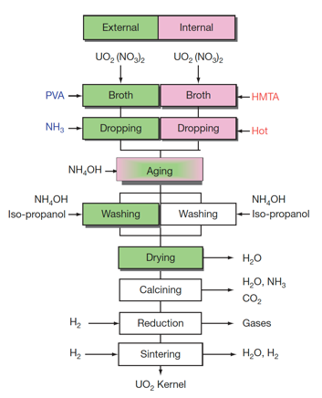
Fuel Kernel Fabrication
The mechanical strength of the coated layers depends on their thickness and sphericity, and thus strongly depend on the diameter and sphericity of the kernels
Vibrating nozzles from which droplets are emitted with high speed were developed for uniform and spherical kernel fabrication
A process is applied to prevent the deformation of droplets while they are landing on the ammonia water, where droplets are solidified while falling in ammonia gas blown against them

Slide 31
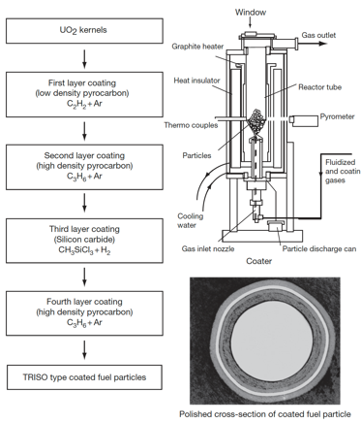
SiC (and PyC) Fabrication
The coating technology of both the SiC and PyC layers involves a fluidization of the kernel microsphere bed and chemical vapor deposition (CVD) coating
TRISO coating process is divided into four coating processes for the buffer, IPyC, SiC, and final OPyC layers
A specific mixture of gases is used for the deposition of each layer
buffer: C2H2+Ar; IPyC/OPyC: C3H6+Ar; SiC: CH3SiCl3+H2

Slide 32
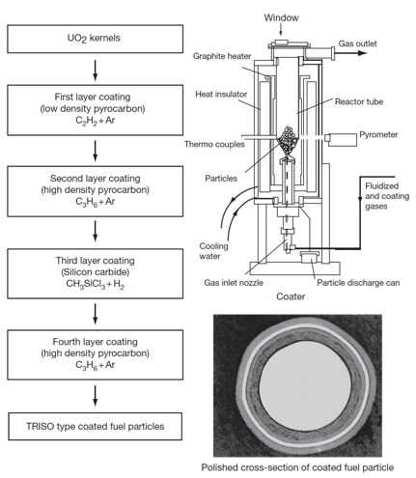
TRISO Fabrication
Rigorous control is applied at every step of the fabrication process to produce high-quality, very low-defect fuel
Defect levels are typically on the order of one defect per 100,000 particles
Specifications are placed on the diameters, thicknesses, and densities of the kernel and layers; the sphericity of the particle; the stoichiometry of the kernel; the isotropy of the carbon; and the acceptable defect levels for each layer

Slide 33
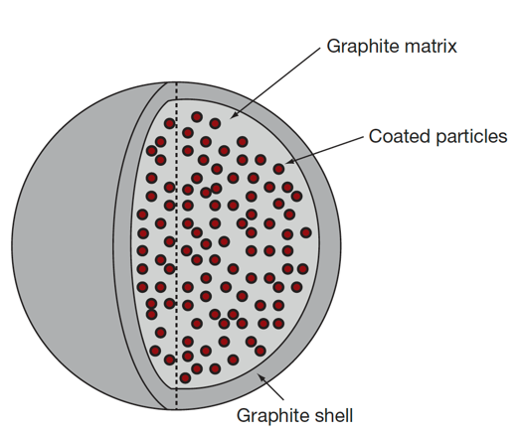
Pebble Fabrication
The fuel element of the pebble bed type HTGR is a spherical fuel element
The coated particles are overcoated with a layer of matrix graphite powder (MGP) and pressed to the core of a fuel sphere
Then, an additional 5-mm layer of matrix graphite material is added to form a ‘nonfuel’ zone
The resulting fuel sphere gets its final diameter by a machining process and is then carbonized and annealed at 2000C

Slide 34
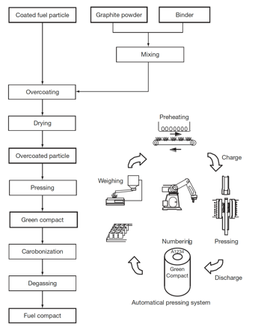
Compact Fabrication
HTGR fuel elements are graphite compacts stacked into a graphite core
To form compacts, coated fuel particles are overcoated with the MGP and warm-pressed to make the annular cylinder of green compacts
Green compacts are heat treated for carbonization at 800C and then sintered at 1800C to make fuel compacts
In order to decrease the failure fraction of coating layers, it is necessary to disperse coated fuel particles in a green compact as uniformly as possible

Slide 35
Summary
Sol-gel fabrication of fuel kernels
CVD for buffer, IPyC, SiC, and OPyC
Combine particles into compacts/pebbles with carbon matrix powder
Compacts/pebbles are then sintered to reach final state

